Slide 1

Module 5
Tree-Based Models
Notes:
Guidelines
Use section headers to chunk content in your presentation.
Use the same style of section header throughout your presentation.
Keep your title to no more than 2 lines.

Slide 2

Ensembles
Notes:
Guidelines
Use a title slide at the beginning of your presentation. There are 9 variations of title slides to choose from.
If you will have a series of slideshows, we recommend using the same style of title slide for each presentation.
Keep your title to no more than 2 lines.
Do not change the font style or font size of the title or subtitle.

Slide 3
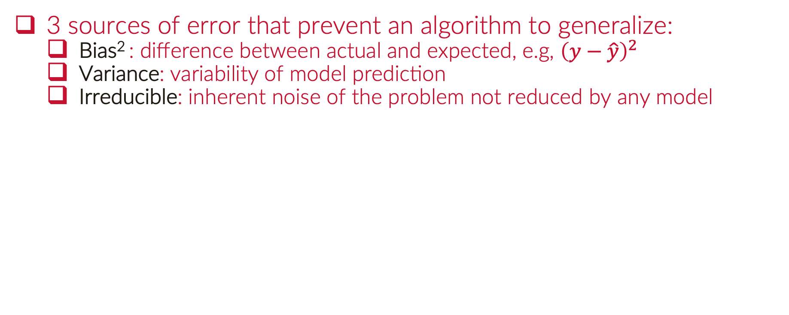
Bias-Variance-Irreducible Errors
3 sources of error that prevent an algorithm to generalize:
Bias² : difference between actual and expected, e.g, ${\left(y−\hat{y}\right)}^{2}$
Variance: variability of model prediction
Irreducible: inherent noise of the problem not reduced by any model

Slide 4
Findings on Decision Trees
Have low bias, high variance
Are easily overfit to the training dataset
Model performance hard to judge on single test dataset

Slide 5
Findings on Decision Trees
Can we reduce the variance of a decision tree?
We can, if we use many and take their average.
How can we average tree? Ensemble Learning
Ensemble Learning: Voting or Averaging

Slide 6
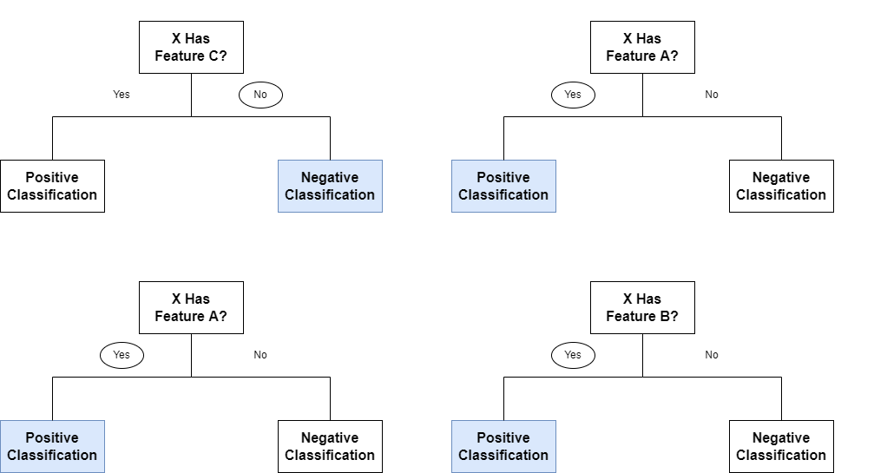
Ensembles of Classification Trees
Combine the predictions from many different tree models.
Combining models should reduce the variance

Slide 7
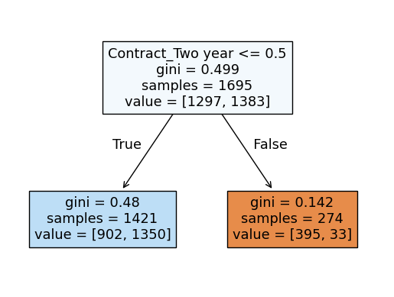
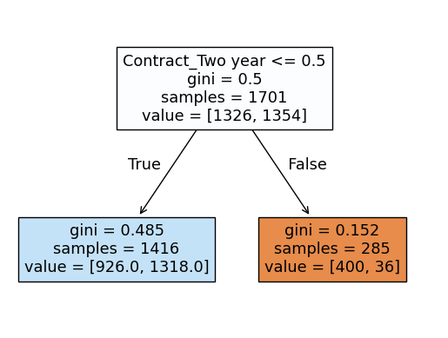
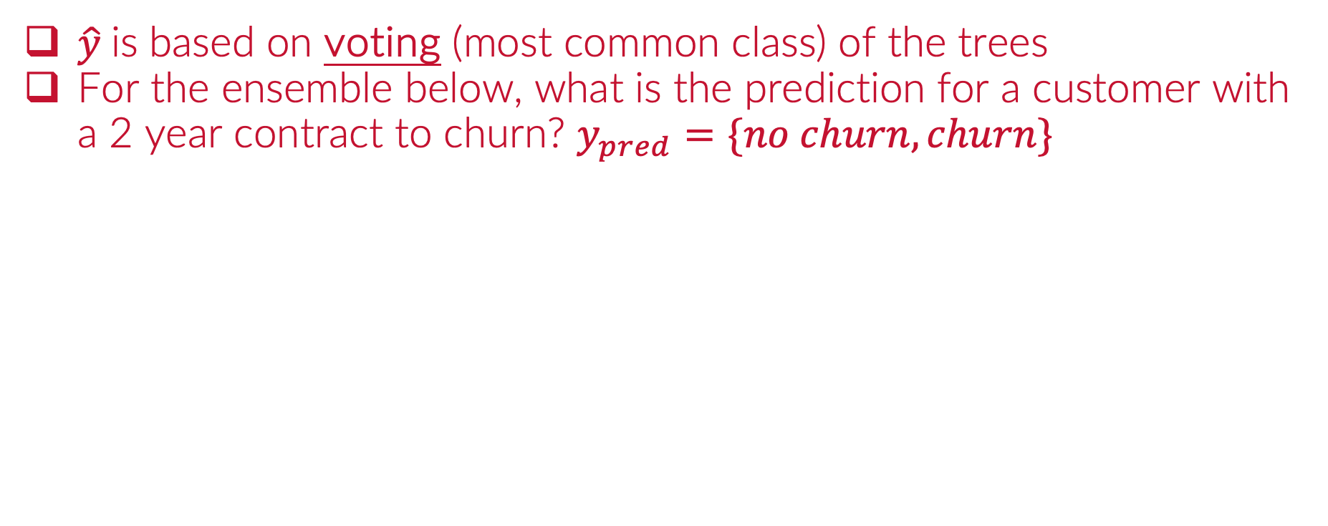
Ensembles of Classification Trees
$\hat{y}$is based on voting (most common class) of the trees
For the ensemble below, what is the prediction for a customer with a 2 year contract to churn? $y_{pred}=\{no churn, churn\}$
Ensemble of 3 Decision Trees

Slide 8
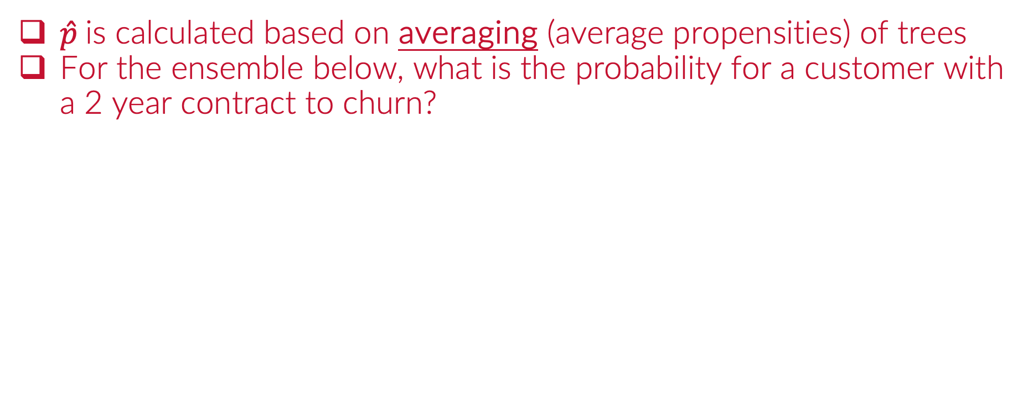
Ensembles of Classification Trees
$\hat{p}$is calculated based on averaging (average propensities) of trees
For the ensemble below, what is the probability for a customer with a 2 year contract to churn?
Ensemble of 3 Decision Trees

Slide 9
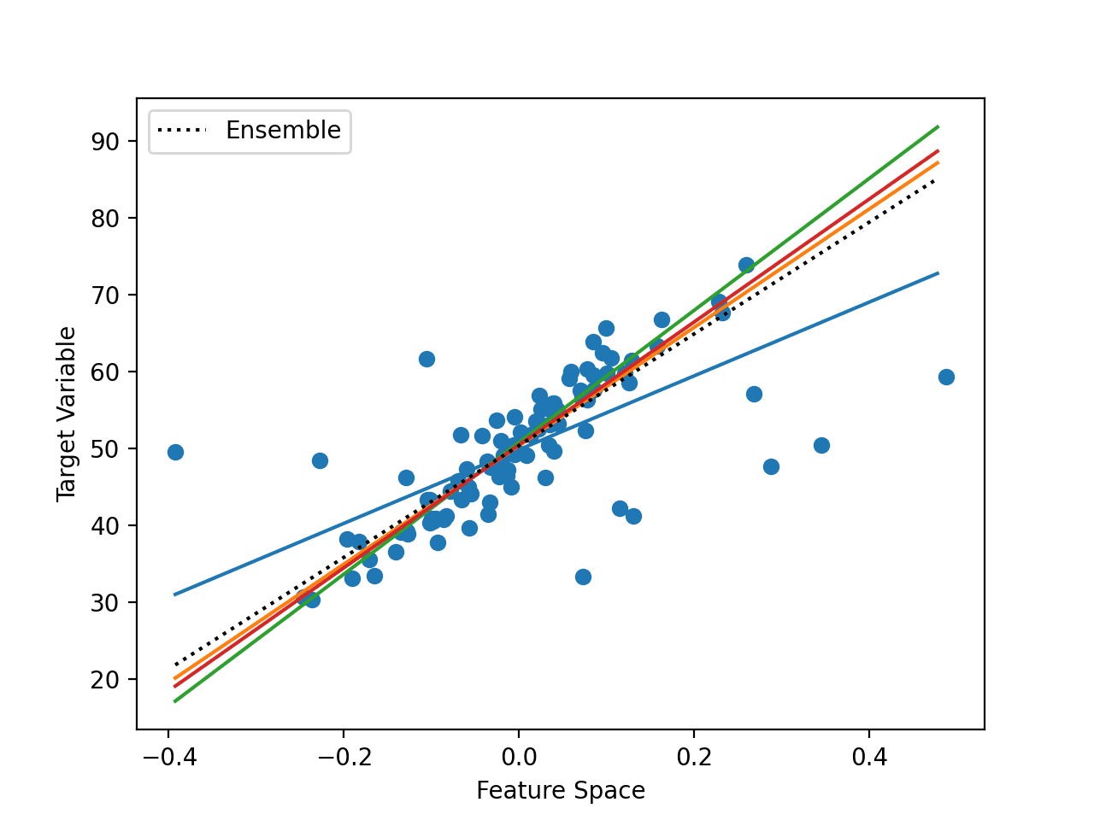
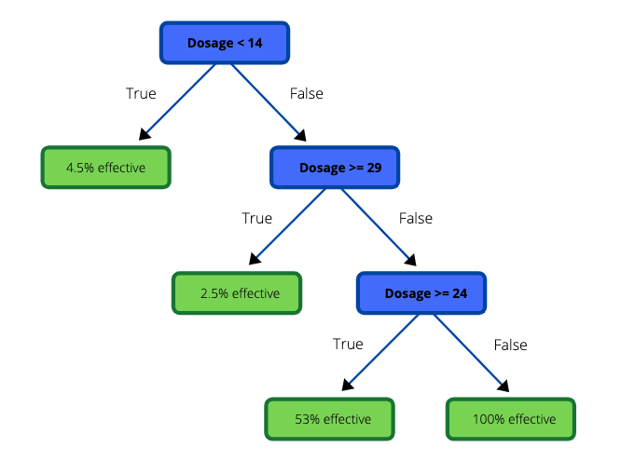
Ensembles of Regression Trees
Combine the predictions from many different tree models.
Combining models should reduce the variance

Slide 10
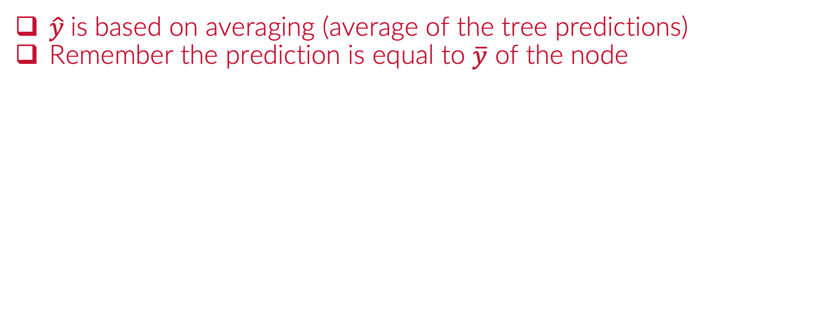
Ensembles of Regression Trees
$\hat{y}$is based on averaging (average of the tree predictions)
Remember the prediction is equal to $\overline{y}$ of the node

Slide 11
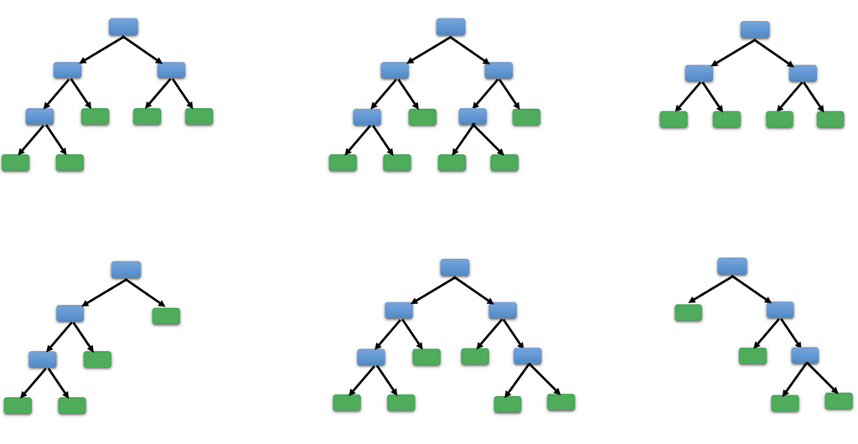
How can we avoid the same trees?
If we fit a tree to the same dataset, we will get similar results
How can we avoid getting the same tree over and over?
c
n
n
n
n
n
c
n₁
n₂
n₃
n₄
n₅

Slide 12
Bagging
Notes:
Guidelines
Use a title slide at the beginning of your presentation. There are 9 variations of title slides to choose from.
If you will have a series of slideshows, we recommend using the same style of title slide for each presentation.
Keep your title to no more than 2 lines.
Do not change the font style or font size of the title or subtitle.

Slide 13
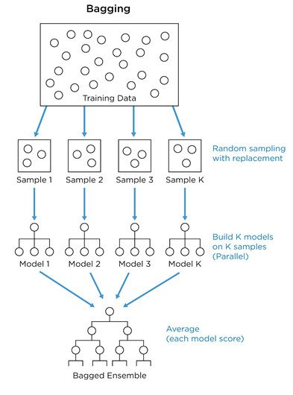
Bootstrap Aggregating (Bagging)
Bootstrapping means to randomly sample with replacement
A bootstrap sample is usually the same size as the original data set.

Slide 14
Bootstrap Aggregating (Bagging)
The out of bag (OOB) score can help estimate performance
Observations not selected in the bootstrap sample can be used to estimate the performance of the ensemble: Out-of-bag Performance.

Slide 15
Python
Notes:
Guidelines
Use a title slide at the beginning of your presentation. There are 9 variations of title slides to choose from.
If you will have a series of slideshows, we recommend using the same style of title slide for each presentation.
Keep your title to no more than 2 lines.
Do not change the font style or font size of the title or subtitle.

Slide 16
Random Forests
Notes:
Guidelines
Use a title slide at the beginning of your presentation. There are 9 variations of title slides to choose from.
If you will have a series of slideshows, we recommend using the same style of title slide for each presentation.
Keep your title to no more than 2 lines.
Do not change the font style or font size of the title or subtitle.

Slide 17
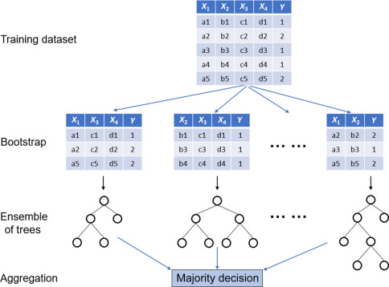
Random Forests
Bagging produces correlated predictions
We can improve bagging by also sampling the variables

Slide 18
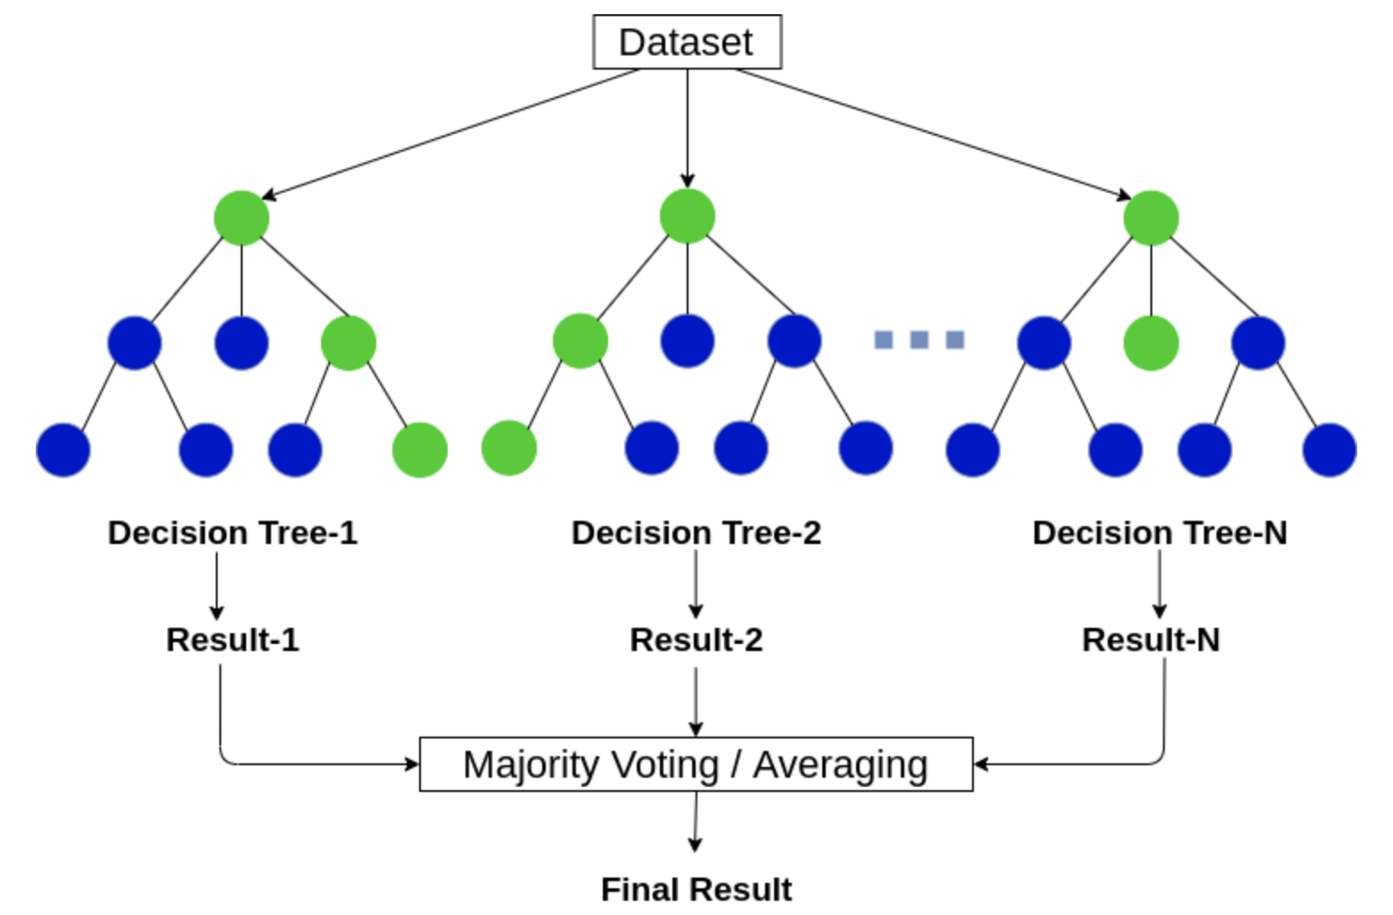
Random Forests
Bagging produces correlated predictions
We can improve bagging by also sampling the variables

Slide 19
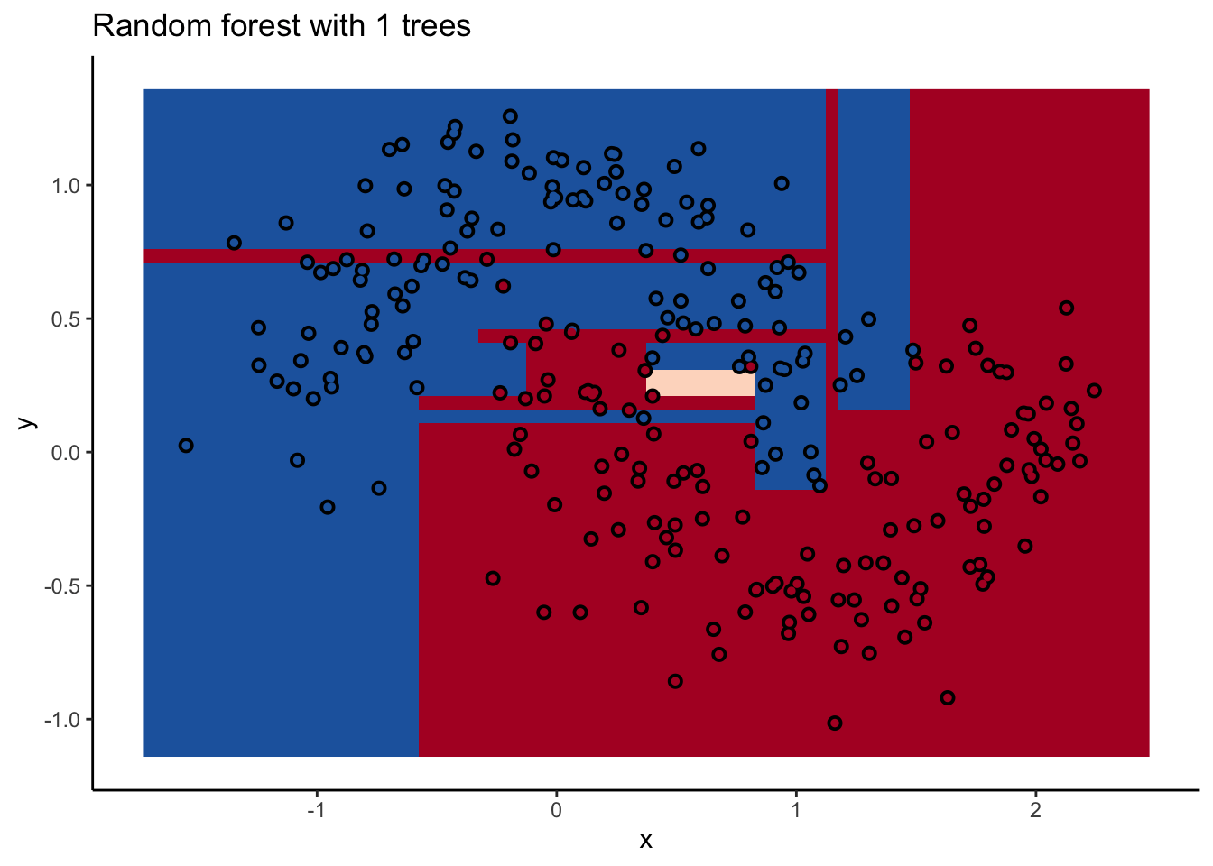
Random Forests
Decision Boundary of RF

Slide 20
Python
Notes:
Guidelines
Use a title slide at the beginning of your presentation. There are 9 variations of title slides to choose from.
If you will have a series of slideshows, we recommend using the same style of title slide for each presentation.
Keep your title to no more than 2 lines.
Do not change the font style or font size of the title or subtitle.

Slide 21
Boosted Trees
Notes:
Guidelines
Use a title slide at the beginning of your presentation. There are 9 variations of title slides to choose from.
If you will have a series of slideshows, we recommend using the same style of title slide for each presentation.
Keep your title to no more than 2 lines.
Do not change the font style or font size of the title or subtitle.

Slide 22
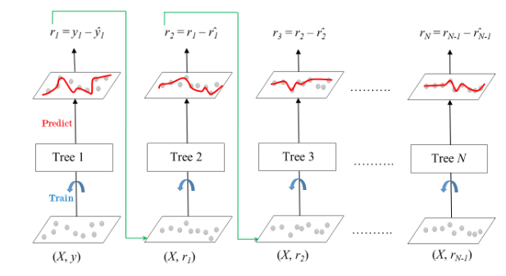
Boosted Trees (Boosting)
In boosting trees are grown sequentially.
Each tree is fit on a the residuals of the previous tree.

Slide 23
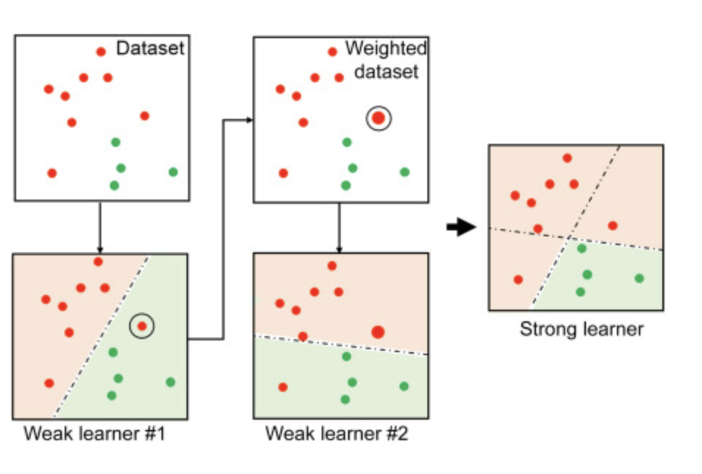
Boosted Trees (Boosting)
In boosting trees are grown sequentially.
Each tree is fit on the residuals of the previous tree.

Slide 24
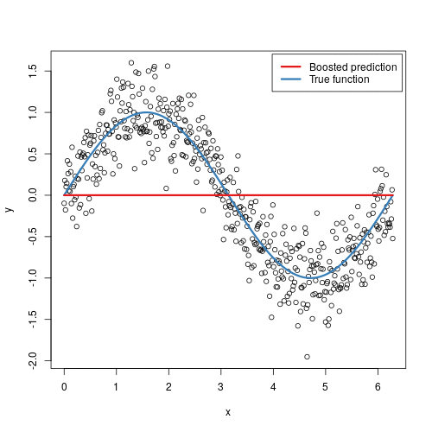
Boosted Trees (Boosting)
In boosting trees are grown sequentially.
Each tree is fit on a the residuals of the previous tree.

Slide 25
Python
Notes:
Guidelines
Use a title slide at the beginning of your presentation. There are 9 variations of title slides to choose from.
If you will have a series of slideshows, we recommend using the same style of title slide for each presentation.
Keep your title to no more than 2 lines.
Do not change the font style or font size of the title or subtitle.

Slide 26
Gradient-Based Boosting
Notes:
Guidelines
Use a title slide at the beginning of your presentation. There are 9 variations of title slides to choose from.
If you will have a series of slideshows, we recommend using the same style of title slide for each presentation.
Keep your title to no more than 2 lines.
Do not change the font style or font size of the title or subtitle.

Slide 27
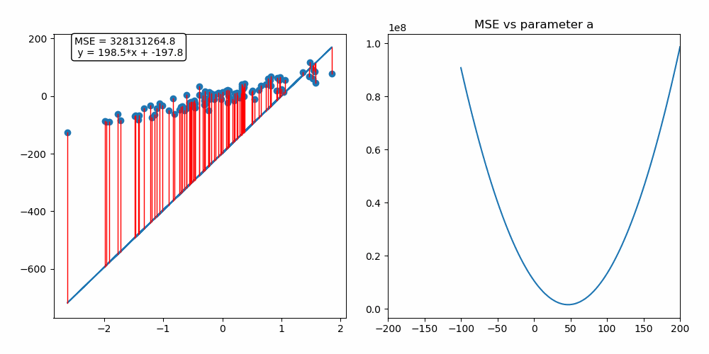
Gradient Boosting
Gradient descent is an optimization algorithm used to minimize some function by iteratively moving in the direction of steepest descent

Slide 28
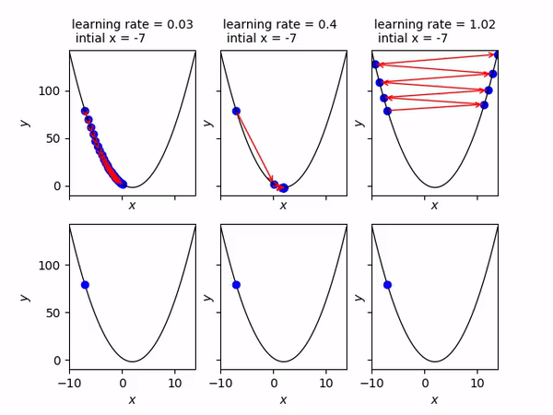
Gradient Boosting
Important hyper-parameter is the step size (learning rate)

Slide 29
Python
Notes:
Guidelines
Use a title slide at the beginning of your presentation. There are 9 variations of title slides to choose from.
If you will have a series of slideshows, we recommend using the same style of title slide for each presentation.
Keep your title to no more than 2 lines.
Do not change the font style or font size of the title or subtitle.

